Slide 1
Design a flower catalogue app for a florist
Marjan Abbasifar

Slide 2
Project overview
The product:
Insert a few sentences about the app, website, or other product that you designed and the target users
Preview of selected polished designs.
Project duration:
Insert the time that you worked on this design project - e.g., Month Year to Month Year

Slide 3
Project overview
The problem:
Insert one to two sentences about the problem(s) you were trying to solve.
The goal:
Insert one to two sentences about the goal of the project.

Slide 4
Project overview
My role:
Identify your role in the project - e.g., lead UX designer, UX researcher, etc.
Responsibilities:
List the responsibilities you had throughout the project - e.g., user research, wireframing, prototyping, etc.

Slide 5
User research
Personas
Problem statements
User journey maps
Understanding
the user

Slide 6
User research: summary
I conducted several interviews with users who are flowers and plants lover and tend to buy flowers and plants for different reasons, for example: to adorn their home, their garden, workplace, and also to surprise their friends or family members.
Most of these users are adults who prefer to purchase flowers and plants online because of lack of time, difficulties that they might face with in transfering the flowers and so on, however they have also different concerns about purchase flower online based on their stories for example some of them are concern about the quality of flowers, delivery options,get information about the maintenance condition, ordering flowers in advance and specify the time that they want to pick up their flowers.

Slide 7
User research: pain points
1
2
3
4
delivery
Maintenance information
Accessibility
Hard payment
For old people it’s hard to walk or drive and pick up their order.
Without maintenane information it’s impossible to keep the plants and flowers healhty and beautiful.
It’s hard for people with disability such as visual impairment or dyslexia to cope with apps which are not equiped with assistive technologies
It’s frustrating for people to fill out the payment form each time they want to buy a product.

Slide 8
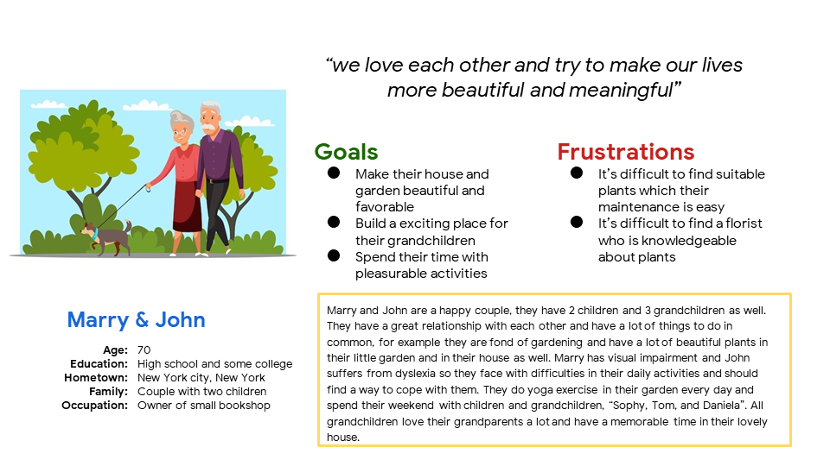
Persona: Marry and John
Problem statement:
Marry and John is an old couple who needs an easy and practical way to order plant and flower in their garden, with the necessary information about their maintenance because, they really care about health and growth of their plants.

Slide 9
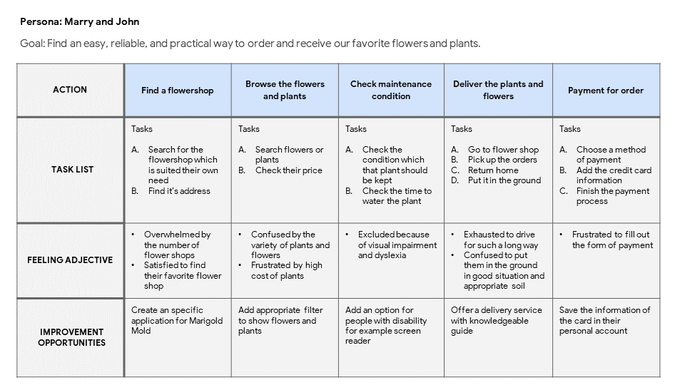
User journey map
Mapping Marry and John’s user journey revealed how helpful it would be fo users to have access to a dedicated Marigold Mold florist app

Slide 10
Paper wireframes
Digital wireframes
Low-fidelity prototype
Usability studies
Starting
the design

Slide 11
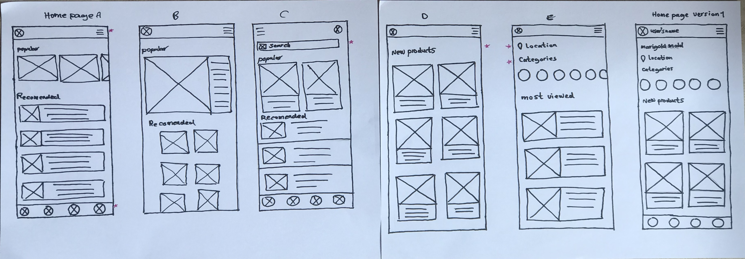
Paper wireframes
My goal is ro help people find their product as soon as possible and making the order process easy for the. In the home page I categorize different products in order to make them easy to find
Stars were used to mark the elements of each sketch
That would be used in the initial digital wireframes.

Slide 12
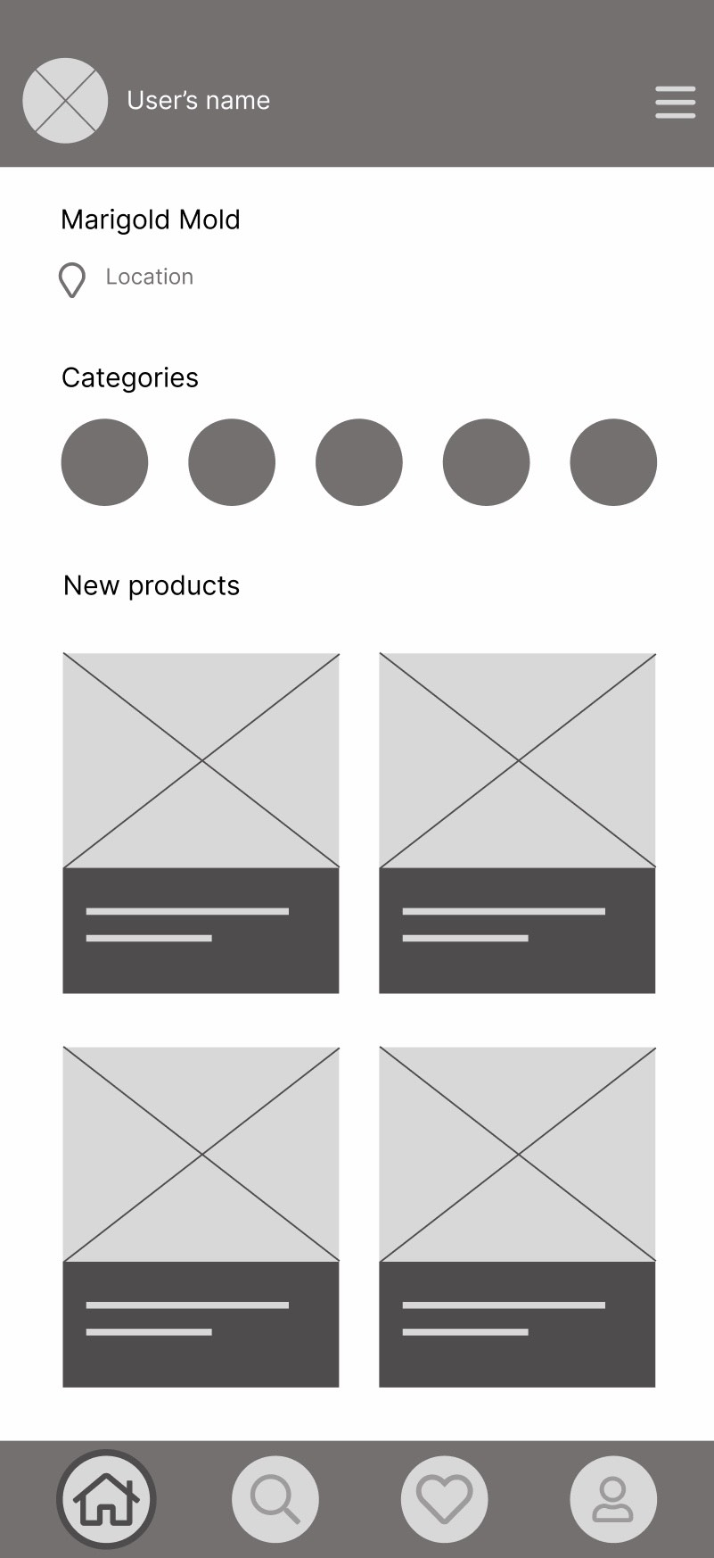
Digital wireframes
User can find the locarion
In home page the app provides an organized way for user to surf between different products and select different categories then they can choose their favorite products
User can choose category

Slide 13
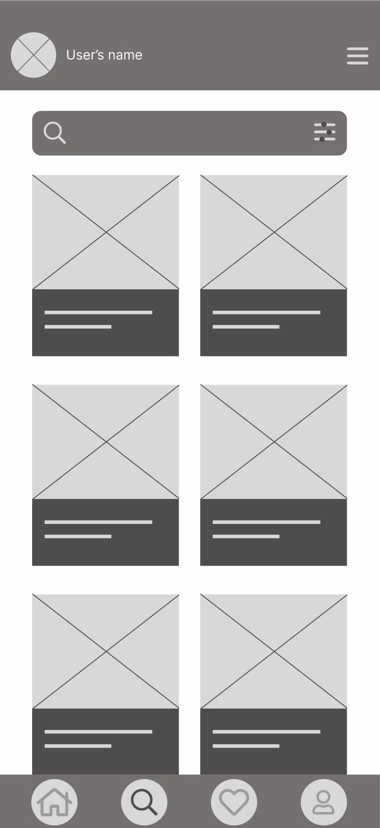
Digital wireframes
This option helps user to apply filters on searching
In the search page users can look for their favorite products and apply different filter to limit the search result.

Slide 14
Low-fidelity prototype
[Link to low-fidelity prototype and brief description of the user flow]

Slide 15
Usability study: findings
Write a short introduction to the usability studies you conducted and your findings.
Round 1 findings
Round 2 findings
1
Confusing home page must be transferred in to simpler and more intuitive version
1
Insert finding
2
Different pages must be well-detaild such as, category section
2
Insert finding
3
Shopping icon must be merged with “Add to cart” in a written form.
3
Insert finding

Slide 16
Refining
the design
Mockups
High-fidelity prototype
Accessibility

Slide 17
Mockups
Before usability study
After usability study
[]
Image of selected screen before usability study
Image of selected screen after usability study

Slide 18
Mockups
Before usability study
After usability study
[Your notes about goals and thought process]
Image of selected screen before usability study
Image of selected screen after usability study

Slide 19
Mockups
Main mockup screen for display
Main mockup screen for display
Main mockup screen for display
Main mockup screen for display

Slide 20
High-fidelity prototype
[Link to high-fidelity prototype]
Screenshot of prototype with connections or prototype GIF

Slide 21
Accessibility considerations
1
2
3
Insert one to two sentence summaries describing each accessibility consideration applied in your designs.
Insert one to two sentence summaries describing each accessibility consideration applied in your designs.
Insert one to two sentence summaries describing each accessibility consideration applied in your designs.

Slide 22
Going forward
Takeaways
Next steps

Slide 23
Takeaways
Impact:
Insert one to two sentences summarizing the impact of your designs. In the real world, you’d include data like number of downloads or sign ups, but since this is a course project, you can include a positive quote from a peer or study participant.
What I learned:
Insert a few sentences summarizing what you learned throughout the project.

Slide 24
Next steps
1
2
3
Insert a few sentences summarizing the next steps you would take with this project and why.
Insert a few sentences summarizing the next steps you would take with this project and why.
Insert a few sentences summarizing the next steps you would take with this project and why.

Slide 25
Insert a few sentences summarizing the next steps you would take with this project and why. Feel free to organize next steps in a bullet point list.
Let’s connect!
Insert a brief sentence or two about contacting you and/or reviewing more of your work.
Provide your contact information here. This might include your email address, phone number, and website or link to other professional platforms.

Slide 26
Thank you!

